Slide 1
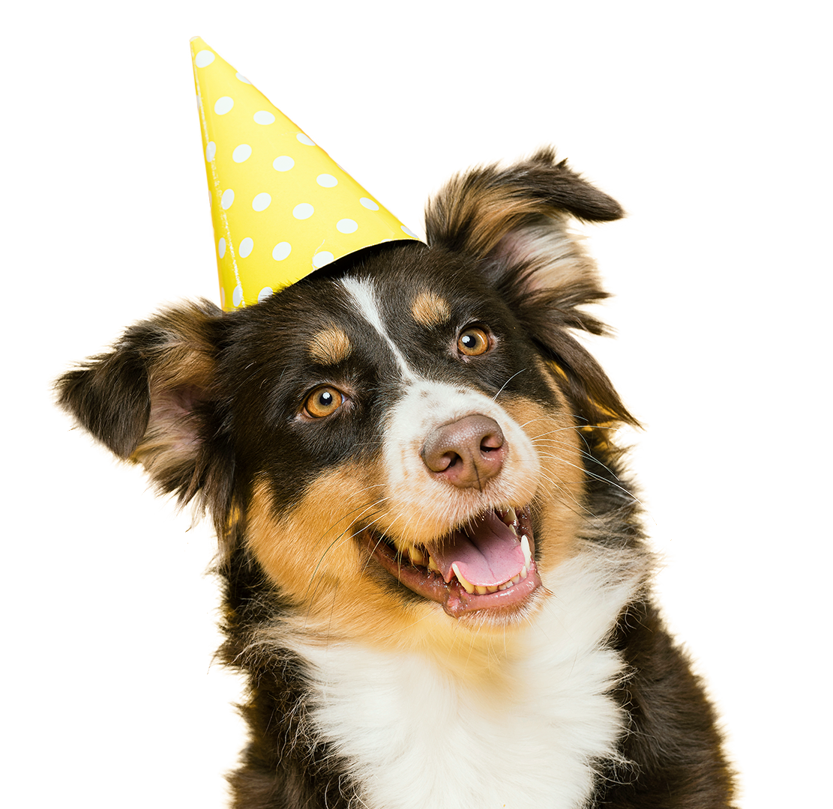

Project 3
Get a pet
Love, animals and more

Slide 2
App: Get a Pet
Create a database by web scraping the 3 main websites looking for adopting a pet (cat or dog) for free:
La SPA : https://www.la-spa.fr/adopter-animaux
30 millions d’amis : https://www.30millionsdamis.fr/
Uncompagnon.fr :https://www.uncompagnon.fr/

Slide 3
Steps
Web sites selection
Web scraping
Data cleanings
Data aggregation
Data Filtering
Output and visualization
Pipeline and tool finalisation

Slide 4
Way to get the data
Web scrap all the links to every animals from the research page of the website
Create a list a of links
Time handling
Error handling for scraping
Webscrap the list of links a get the information from each pet using CSS access
Create dictionary and dataframe for each and then append them into a big Database for one website
Merge the databases (3 in one)
Data Cleaning (nan)
Develop the code to process requests (in the futur)

Slide 5
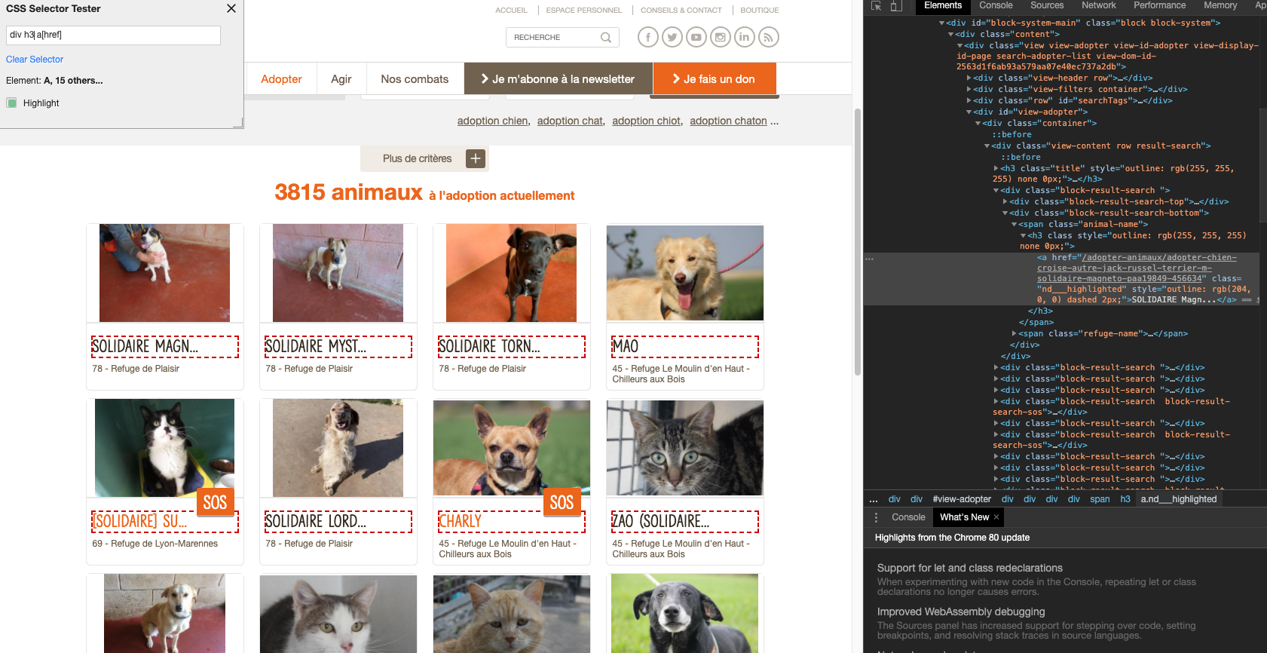

Slide 6
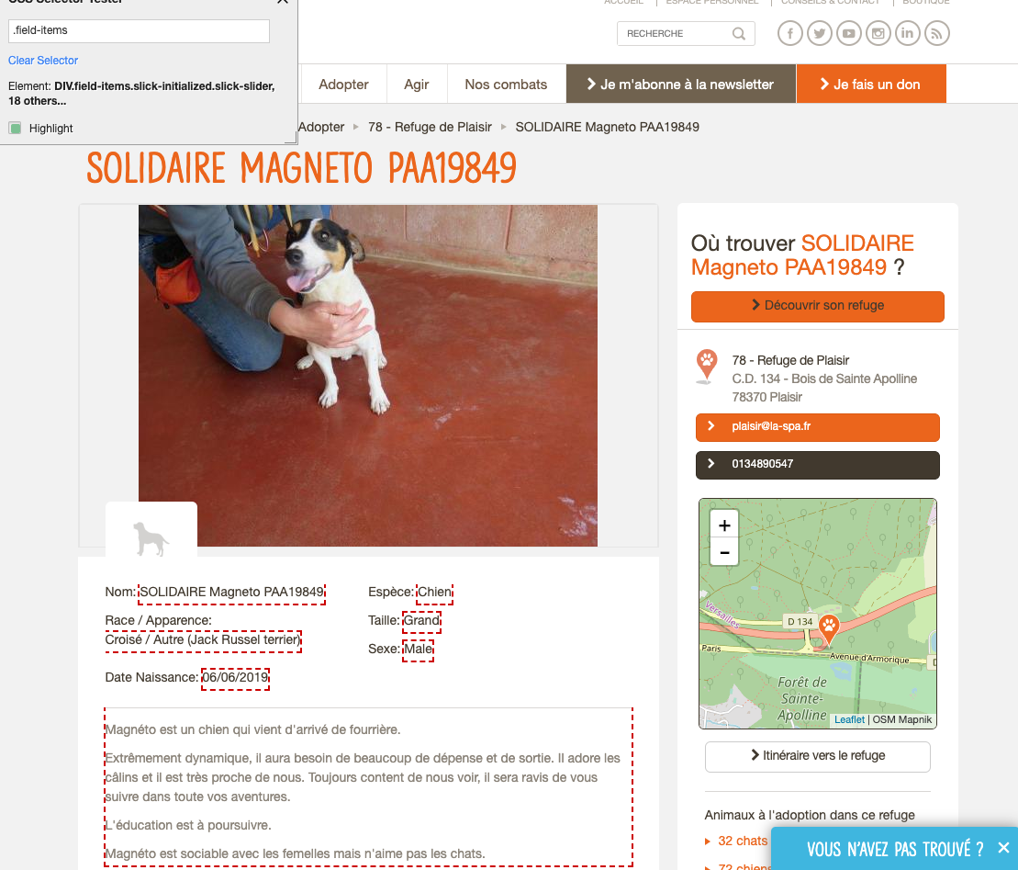
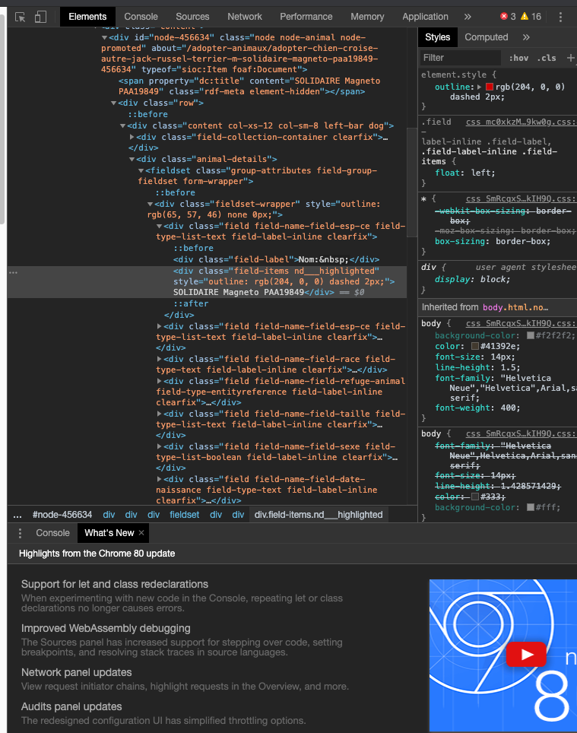

Slide 7

Obstacles
Skills to use CSS selector
Stability of the websites ; error 502 Bad getaway
Get lock by the administrator after to many attempts (not human being)

Slide 8
Tools
Jupyter
Css
Spider

Slide 9
Get a puppy
Your puppy’s love for you can turn your worst day into a happy day

